Slide 1
Capstone Project
Hotel Booking Analysis By Aniket Deshmukh

Slide 2
Outline 1. Problem Statement 2. Data Summary 3. Data Preparation 4. EDA 5. Challenges 6. Conclusion

Slide 3
Problem Statement
❖Tourism is one of the world‘s most rapidly growing industries. Much of its growth is due to higher disposable incomes, increased leisure time and falling costs of travel.
❖A hotel system manages information about rooms, reservations, customers, and customer billing.
❖Hotel industry facing to analyse the problems like change in marketing trends and dynamics, housekeeping issues, customers’ expectations, Data security, mode of bookings etc...
❖We used the given data set to predict the future bookings using pandas data frame techniques.
❖We will be using the data set available to analyze the factors affecting the hotel bookings. f the

Slide 4
Data Summary
Given data set has different columns of variables crucial for hotel bookings. Some of them are:
hotel: The category of hotels, which are two resort hotel and city hotel.
is_cancelled : The value of column show the cancellation type. If the booking was cancelled or not.
Values[0,1], where 0 indicates not cancelled.
lead_time : The time between reservation and actual arrival.
stayed_in_weekend_nights: The number of weekend nights stay per reservation
stayed_in_weekday_nights: The number of weekday nights stay per reservation.
meal: Meal preferences per reservation.[BB,FB,HB,SC,Undefined]
Country: The origin country of guest

Slide 5
Data Summary(contd..)
market_segment: This column show how reservation was made and what is the purpose of reservation. Eg, corporate means corporate trip, TA for travel agency.
distribution_channel: The medium through booking was made. [Direct,Corporate,TA/TO,undefined,GDS.]
Is_repeated_guest: Shows if the guest is who has arrived earlier or not. Values[0,1]-->0
indicates no and 1 indicated yes person is repeated guest.
days_in_waiting_list: Number of days between actual booking and transact.
customer_type: Type of customers( Transient, group, etc.)

Slide 6
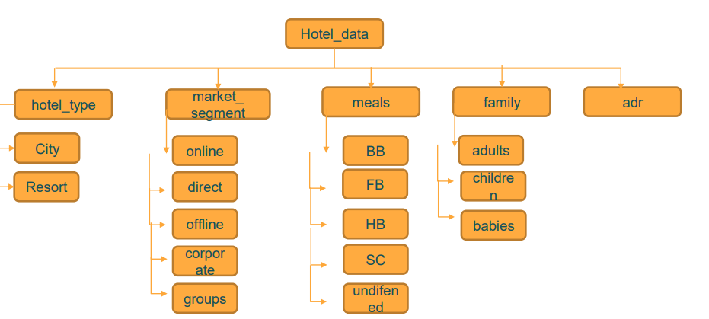

Slide 7
Data Cleaning
Data cleaning is the very first important fundamental thing which every
data scientist must know. It is the process of finding the inaccurate,
incorrect and irrelevant or missing part of a data and then, modifying the
data according to our necessity.
● Steps:
1. Remove duplicate rows.
2. Removing NULL values by replacing zero.
3. Converting datatypes.
4. Adding new columns if necessary.

Slide 8
Data Visualization
Mainly performed using Matplotlib and Seaborn library and the following graph and plots had been used:
1) Bar Plot
2) Pie Chart
3) Heatmap
4) Line Plot
5) Histogram
6) Pie Chart

Slide 9
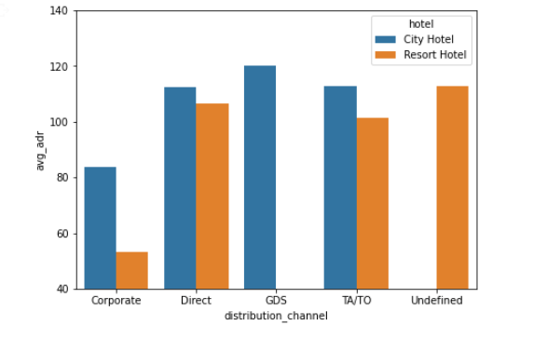
EDA
GDS channel brings higher revenue generating deals for City hotel, in contrast to that most bookings come via TA/TO. City Hotel can work to increase outreach on GDS channels to get more higher revenue generating deals.
Resort hotel has more revnue generating deals by direct and TA/TO channel. Resort Hotel need to increase outreach on GDS channel to increase revenue.

Slide 10
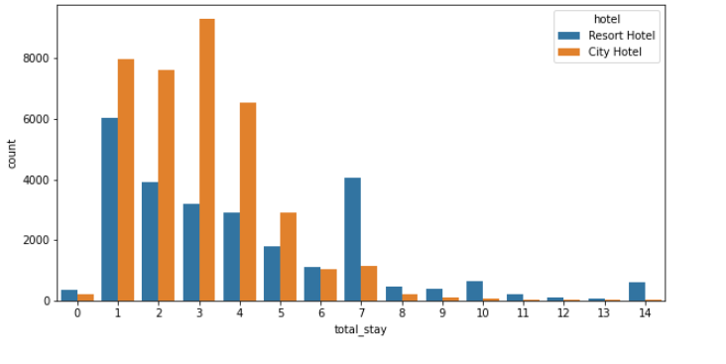
Most common stay length is less than 4 days and generally people prefer City hotel for short stay, but for long stays, Resort Hotel is preferred.

Slide 11
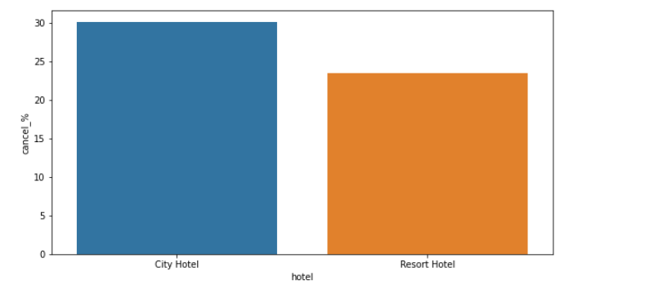
Almost 30 % of City Hotel bookings got canceled.

Slide 12
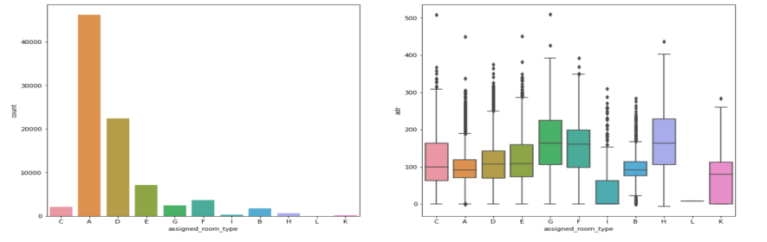
Most demanded room type is A, but better adr rooms are of type H, G and C also. Hotels should increase the no. of room types A and H to maximize revenue.

Slide 13
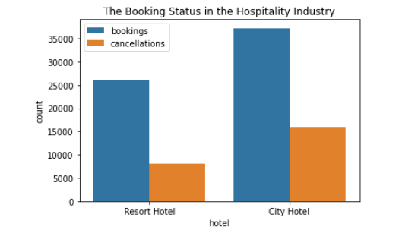
Resort hotel has maximum cancellation than city hotel.

Slide 14
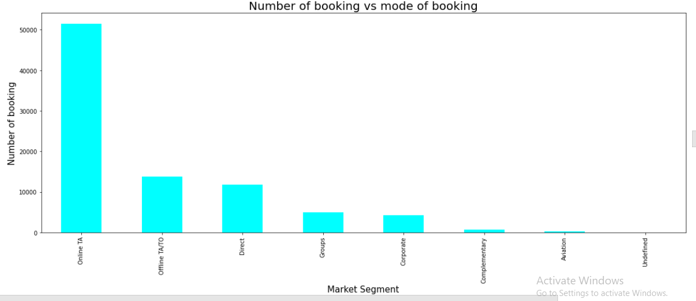
From above graph we can say that Online booking has almost same as sum of other mode of bookings.

Slide 15
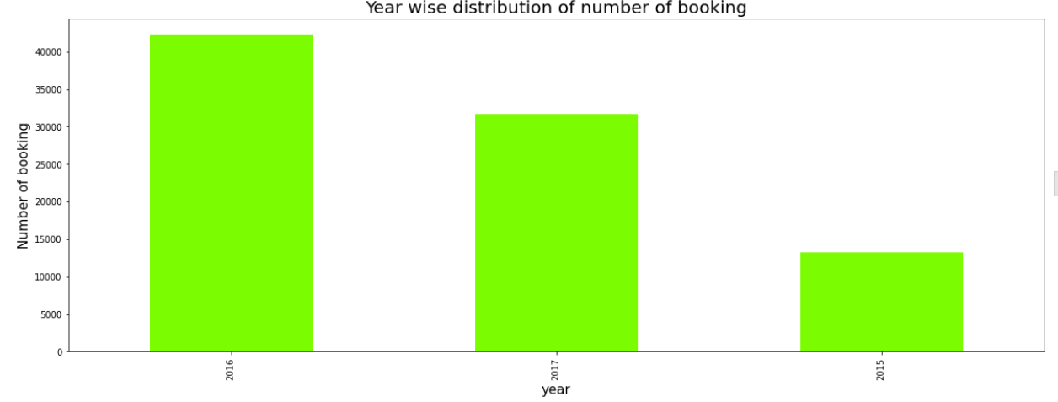
2016 has higher bookings than 2015 and 2017.
From 2015 number of bookings increases in 2016 but booking decreases in 2017.
2016 has higher bookings than 2015 and 2017.
From 2015 number of bookings increases in 2016 but booking decreases in 2017.

Slide 16
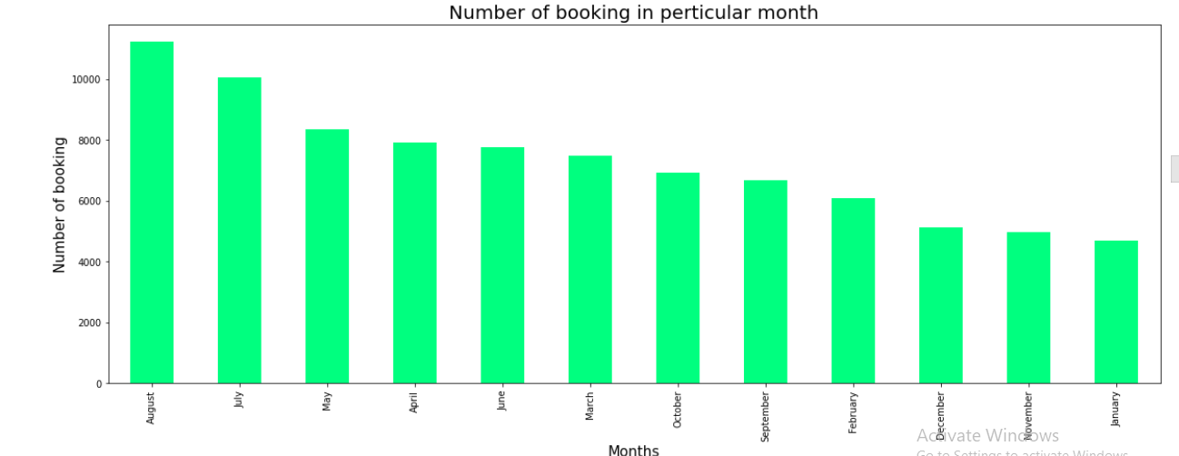
August month has highest number of booking and january month has lowest number of booking.

Slide 17
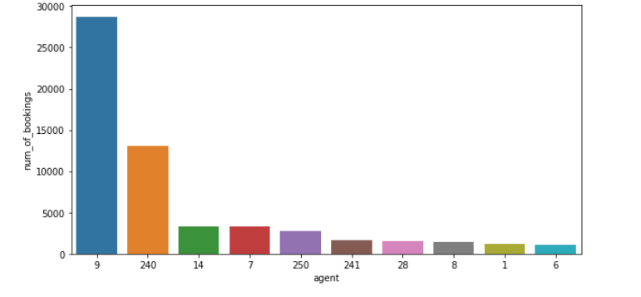
Agent no. 9 has made most no. of bookings

Slide 18
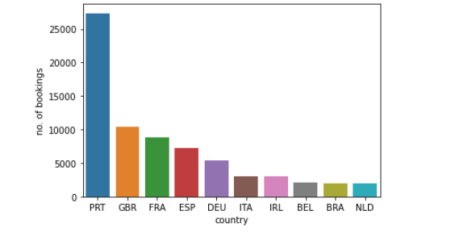
Most of the customers come from Portugal, Great Britain, France and Spain.

Slide 19
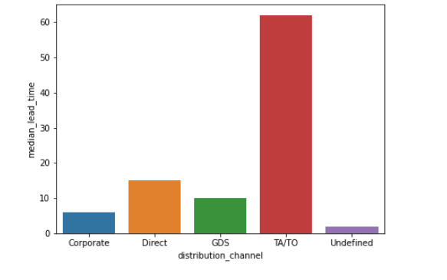
TA/TO is mostly used for planning Hotel visits ahead of time. But for sudden visits other mediums are most preferred.

Slide 20
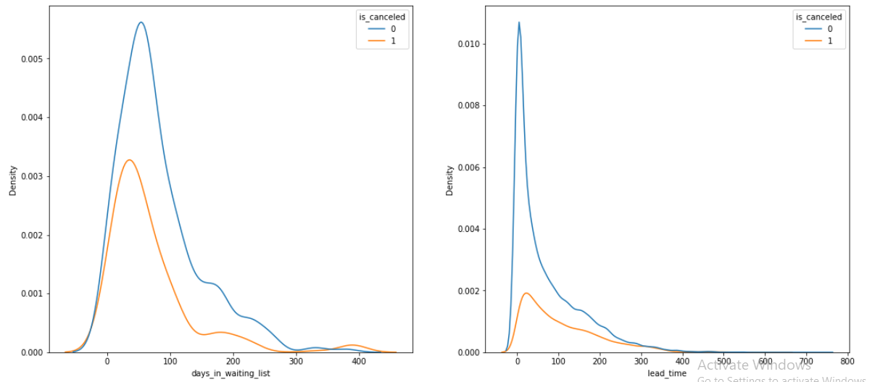
Most of the bookings that are cancelled have waiting period of less 150 days but also most of bookings that are not cancelled also have waiting period of less than 150 days. Hence this shows that waiting period has no effect on cancellation of bookings.
• Also, lead time has no effect on cancellation of bookings, as both curves of cancellation and not cancelation are similar for lead time too.

Slide 21
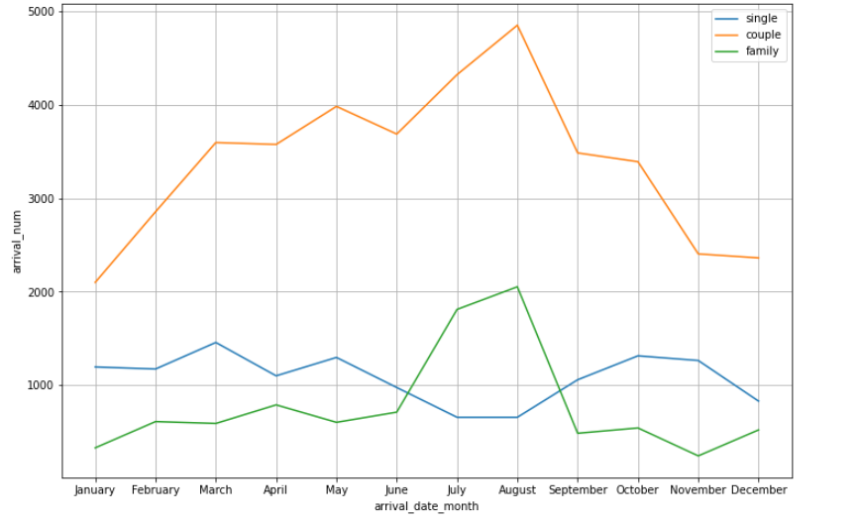
Mostly bookings are done by couples.
It is clear from graph that there is a sudden surge in arrival num of couples and family in months of July and August. So better plans can be planned accordingly at that time for these type of customers.

Slide 22
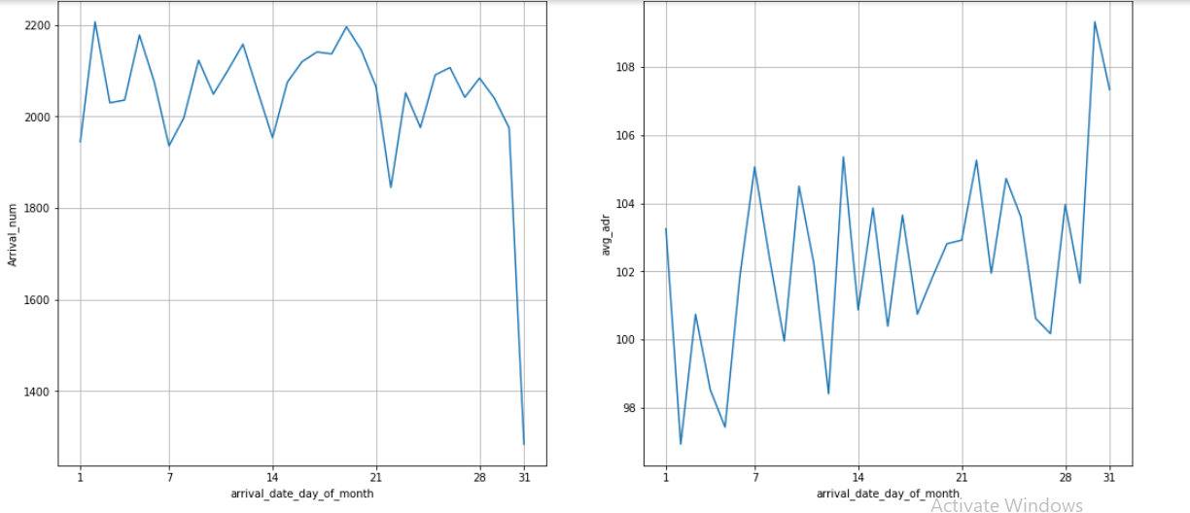
We can see that graph Arrival_num has small peaks at regular interval of days. This can be due to increase in arrival weekend.Also the avg adr tends to go up as month ends. Therefore charge more at the end of month.

Slide 23
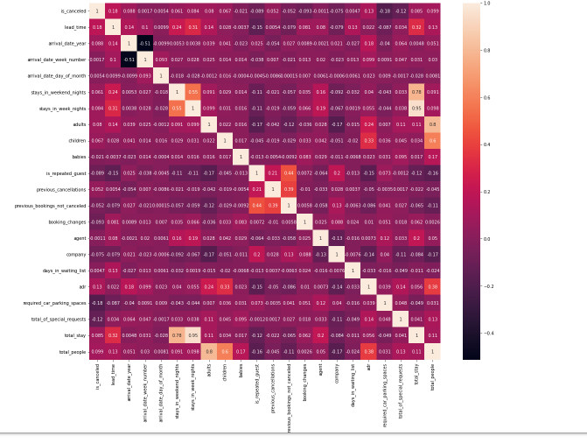
It can be observed arrival_date_week_number and arrival_date_year are 54% negative correlated Company and agent are positive correlated by 35% adr and children are positive correlated by 32%

Slide 24
Challenges
▪ Data cleaning is the difficult thing to resolve in a short time.
▪ It was hard to find which graph technique to use.
▪ Removing null values.
▪ Analyzing the data and visualizing box plot and scatter plot made confused.

Slide 25
Conclusion
1. August month has highest number of booking and january month has lowest number of booking.
2. 2016 has higher bookings than 2015 and 2017.
From 2015 number of bookings increases in 2016 but booking decreases in 2017.
3. From above graph we can say that Online booking has almost same as sum of other mode of bookings.
4. Most demanded room type is A, but better adr rooms are of type H, G and C also. Hotels should increase the no. of room types A and H to maximise revenue.

Slide 26
Conclusion
5. Resort hotel has maximum cancellation than city hotel.
6. Agent no. 9 has made most no. of bookings.
7. Most of the customers come from Portugal, Great Britain, France and Spain.
8. Most common stay length is less than 4 days and generally people prefer City hotel for short stay, but for long stays, Resort Hotel is preferred.

Slide 27
Conclusion
9. Almost 30 % of City Hotel bookings got canceled.
10.TA/TO is mostly used for planning Hotel visits ahead of time. But for sudden visits other mediums are most preferred.
11.GDS channel brings higher revenue generating deals for City hotel, in contrast to that most bookings come via TA/TO. City Hotel can work to increase outreach on GDS channels to get more higher revenue generating deals.
Resort hotel has more revnue generating deals by direct and TA/TO channel. Resort Hotel need to increase outreach on GDS channel to increase revenue.

Slide 28
Conclusion
12. We can see that graph Arrival_num has small peaks at regular interval of days. This can be due to increase in arrival weekend.\ \ Also the avg adr tends to go up as month ends. Therefore charge more at the end of month.
13. Mostly bookings are done by couples(although we are not sure that they are couple as data doesn't tell about that)
It is clear from graph that their is a sudden surge in arrival num of couples and family in months of July and August. So better plans can be planned accordingly at that time for these type of customers.
re similar for lead time too.

Slide 29


